Slide 1
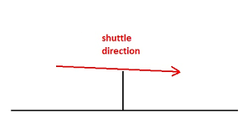
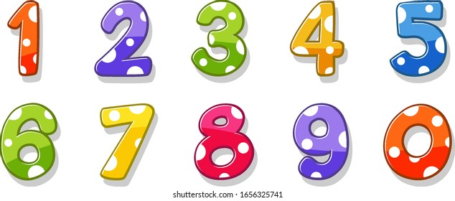




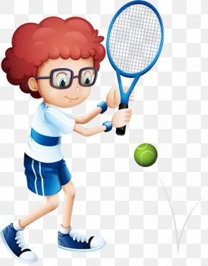
a. Anxiety
b. Visualization
c. Backhand
d. Deuce
e. Drive

Slide 2
a. Anxiety
b. Visualization
c. Backhand
d. Deuce
e. Drive

Slide 3
a. Anxiety
unpleasant inner state/negative feeling
b. Visualization
create an image or a series of images relevant to their sport
a hit in which the arm is brought across the body with the back of the hand facing the same direction as the hit itself
c. Backhand
d. Deuce
the score in badminton when both players have 20 points
e. Drive
you hit it hard so that ball/shuttlecock travels a long way

Slide 4


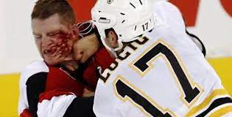

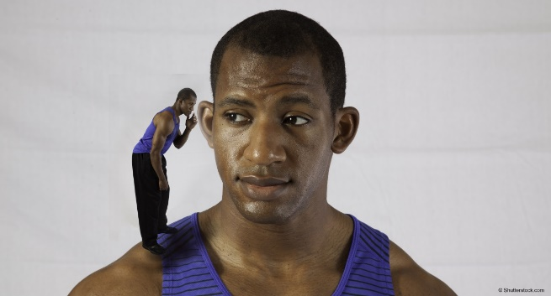
a. Passing
b. Self-talk
c. Self-awareness
d. Aggression
e. Psychophysiology

Slide 5
a. Passing
b. Self-talk
c. Self-awareness
d. Aggression
e. Psychophysiology

Slide 6
the act of kicking, throwing, or hitting the ball to someone in your own team
a. Passing
the verbalization or statements athletes repeat to themselves prior to or during skill execution
b. Self-talk
having knowledge and perception of one's own: Strengths and weaknesses. Thoughts, emotions, and behaviors
c. Self-awareness
any form of behaviour directed toward the goal of harming of injuring another live being who is motivated to avoid such treatment
d. Aggression
e. Psychophysiology
the study of the relationship between physiological and psychological phenomena

Slide 7

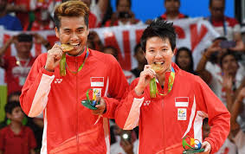
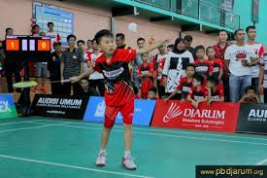
Sport Achievement
Donny Wira Yudha Kusuma

Slide 8
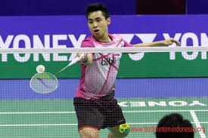
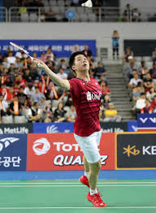
Kho Henrikho Wibowo | Name | Kevin Sanjaya Sukamuljo
180 cm | Height | 168 cm
24 | Age | 23
222nd | World rank | 1st
National Champion | Highest achievement | Badminton World Champion
18 | Age for get highest achievement | 22
Djarum | Club | Djarum
5 | Start play badminton | 11
- | Sport before | Football, swimming

Slide 9
Make a group & answer the question
What is the name of each badminton athlete?
How old are they?
What is the rank for the both athletes?
What is The highest achievement for each athlete?
What sport did they do before badminton?

Slide 10
Make a group & answer the question
Why is Kevin better than Henrikho?, as you know, Henrikho played badminton before Kevin did?

Slide 11
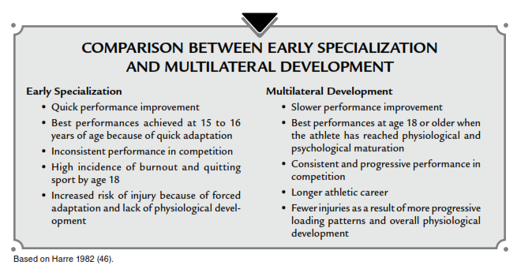

Slide 12
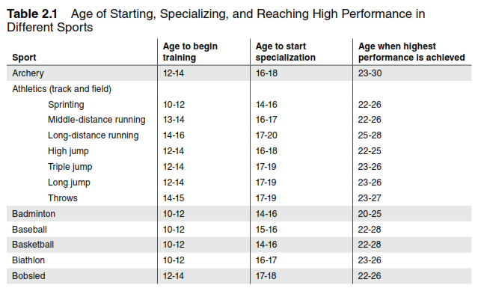

Slide 13

CLIL
Content and Language Integrated Learning
Lembaga Pengembangan Pendidikan dan profesi (LP3) UNNES
Content and language
integrated learning
Donny Wira Yudha Kusuma, Ph.D

Slide 14
Content and Language Integrated Learning
Lembaga Pengembangan Pendidikan dan profesi (LP3) UNNES
Introduction to CLIL
CLIL refers to situation where subjects, or parts of subjects, are taught through a foreign
language with dual-focused aims, namely the learning of content, and the simultaneous
learning of a foreign language (Marsh, 2002)
COURSES:
Introduction of CLIL
Scaffolding
Lesson plan
Evaluation

Slide 15
Content and Language Integrated Learning
Indonesia Australia Language Foundation (IALF)
Introduction to CLIL
CLIL lebih dari sekedar mengajar subjek perkuliahan dengan menggunakan bahasa inggris, sering disebut dengan kelas imersi atau bilingual
bukan hanya mengajar dalam bahasa inggris daripada bahasa indonesia, konten diajarkan dengan dan melalui bahasa Inggris
ini penting: konten masih menjadi fokus utama. Di ruang kelas CLIL, siswa adalah pembelajar aktif, bukan pasif

Slide 16
Content and Language Integrated Learning
Indonesia Australia Language Foundation (IALF)
CLIL Principle (4C’s)
Content/Konten | pokok bahasan - ini didahulukan, bisa jadi sejarah, kalkulus dsb. PRINSIP UTAMA, 3 prinsip yg lain berdasarkan hal ini. CLIL tidak akan berhasil jika konten tidak jelas
Comunication/Komunikasi | Belajar bahasa dan penggunaannya. Termasuk menulis dan bicara. Mengurangi Teacher Talking Time dan meningkatkan interaksi antar siswa Area komunikasi: -BICS (basic interpersonal communication skills): sosial dan percakapan -CALP (cognitive academic language proficiency): bahasa akademik
Cognition/Kognisi | Belajar dan berpikir, dosen memberikan tantangan pada mahasiswa dengan ketrampilan kognitif Kognisi= berpikir kritis dalam memahami konten/materi untuk memecahkan masalah dan merefleksikan hasil belajar HOT (higher order thinking): creating, evaluating & analyzing LOT (lower order thinking): applying, understanding, remembering
Culture/Budaya | Mempersiapkan mahasiswa dalam berperan di masyarakat Belajar dengan budaya yang berbeda

Slide 17
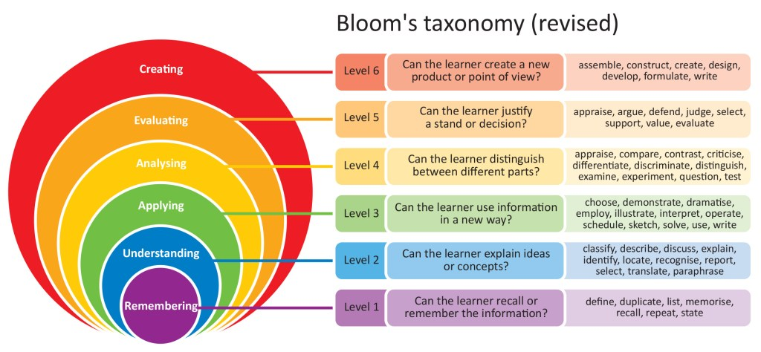
Content and Language Integrated Learning
Indonesia Australia Language Foundation (IALF)
KOGNISI
HOT
LOT

Slide 18
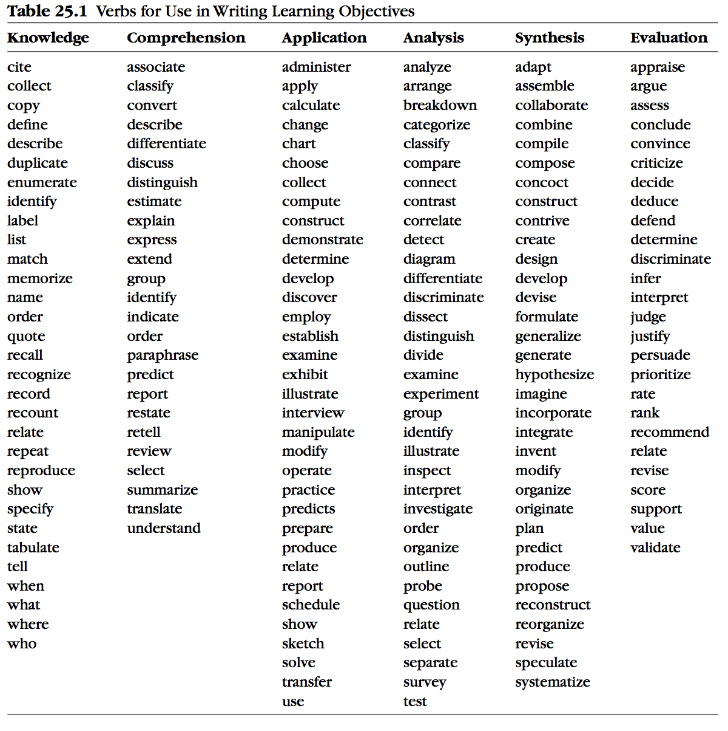
Content and Language Integrated Learning
Indonesia Australia Language Foundation (IALF)

Slide 19
Dosen harus:
Content and Language Integrated Learning
Indonesia Australia Language Foundation (IALF)
Mengurangi waktu dosen berbicara
Memberikan S-S waktu untuk bicara
Memancing untuk siswa berbicara
Menyediakan waktu berpikir siswa
Berikan pertanyaan open-ended questions
Mengaktifkan pengetahuan: top-down & bottom-up
Gunakan alat bantu/media: realia, graph, charts, photo, etc. khususnya bagi siswa dengan inggris rendah

Slide 20
Possible outline of CLIL Lecture
Content and Language Integrated Learning
Indonesia Australia Language Foundation (IALF)
New Content
Main Learning
Extension
Learning
New Language
Familiar Language
Warm Up
Main Intro
Familiar Content

Slide 21
Scaffolding content & language learning
Content and Language Integrated Learning
Indonesia Australia Language Foundation (IALF)
Siswa harus fokus pada 2 hal di saat yang sama: bahasa inggris & konten/materi – bantuan – paham
Dosen – bantuan – memecahkan masalah
Scaffolding: bantuan:
  Graphic organizers: bar chart, binary key, carroll diagram, cycle, mind map, flow, grid, line graph, pie chart, process diagram, quadrants, storyboard, table, time-line, tree diagram, venn diagram
  Glossaries/definisi
  Simplified language
  Picture & realia
  Clear instructions
  Adapting material

Slide 22
Question
Content and Language Integrated Learning
Indonesia Australia Language Foundation (IALF)
Why ask question?
It’s more fun for students and teachers
It makes students active partners in the learning process
It empowers learners to acquire knowledge
What to ask?
Guessing games are often (but NOT always) a waste of time
Ask students to answer based on either:
  What they already know : (remembering, activating background knowledge)
  What they can work out: (analyzing, activating background knowledge)

Slide 23
Question
Content and Language Integrated Learning
Indonesia Australia Language Foundation (IALF)
How to ask?
Look at what and how you plan to teach:
How much student involvement is there? (keterlibatan)
What might the students….
  …already know?
  …be able to work out?
Two things to remember:
If they don’t know it, tell them
Don’t “cheat” by using silly clues until they guess what you want them to say, but have no idea of the meaning

Slide 24
Question
Content and Language Integrated Learning
Indonesia Australia Language Foundation (IALF)
Two types:
Display questions – the teacher already know the answer
  “how many posters are in the picture of the bedroom?”
“Real” questions – the teacher doesn’t know the answer
  “how many poster do you have in your bedroom?”

Slide 25
Interactive Teaching
Content and Language Integrated Learning
Indonesia Australia Language Foundation (IALF)
Menginstruksikan di mana guru secara aktif melibatkan siswa dalam proses belajar mereka: T – S, S – S, audiovisual, demonstrasi. Shg siswa menjadi aktif
Cara efektif untuk mengikutsertakan siswa dalam pembelajaran:
  Brainstorming – various techniques:
  Think, pair, and share
  Buzz session: grup
  Incident process: case study format
  Q & A sessions

Slide 26
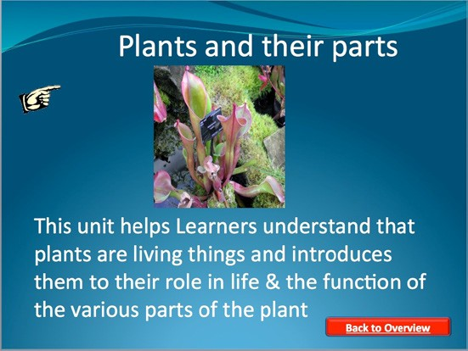

Slide 27
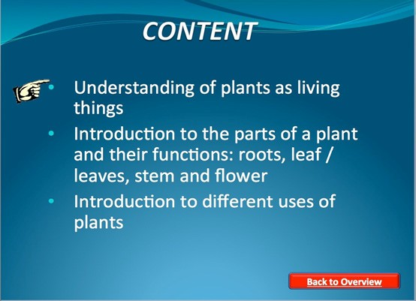

Slide 28
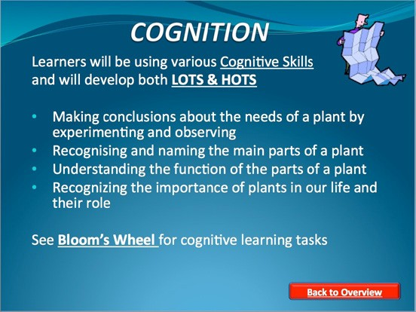

Slide 29
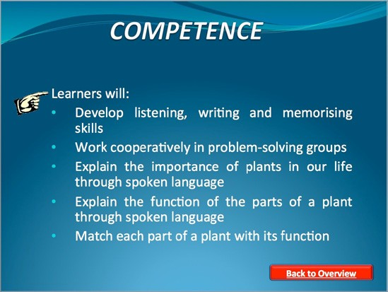

Slide 30
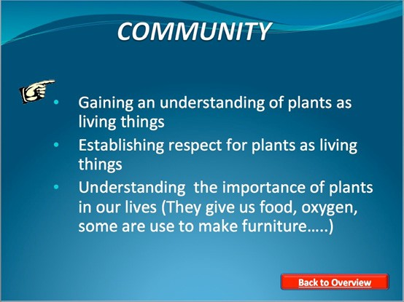

Slide 31
CLIL Lesson Plan
Content and Language Integrated Learning
Indonesia Australia Language Foundation (IALF)
Name:
Date:
Time:
Content | Complete and incomplete dominant gene action
Teaching Aims | To teach students the concept of complete and incomplete dominant gene action
Learning outcomes | By the end of the lesson, students will able to differentiate between a complete and incomplete dominant gene action
Communication | Vocabulary: heterozygous, homozygous, complete and incomplete dominant gene action Present tense to describe facts
Cognition | Comparing: between complete and incomplete dominant gene action Summarize: summarizing Identifying: matchijng pictures with complete and incomplete dominant gene action Remembering: the concept
Resources | Power point slides Video Cards

Slide 32
Procedure Sheet
Content and Language Integrated Learning
Indonesia Australia Language Foundation (IALF)
Stage | Time | Interaction patterns | Aids & materials | Detail procedure | Stage aims
1 | 4 | T – S | Slide 1 & 2 | Recall last lesson Students work in pairs to answer the 2 questions feedback
2 | 1 | T – S | Slide 3 | Present the aims of this lesson
3 | 5 | T – S | Slide 4 & video | Ask students “is fish genetics important?” why? Before playing the video, ask student? Compare answer feedback
4 | 7 | T – S | Slide 5 & 8 | Present the concepts of the content Ask question related to the concepts
5 | 3 | S – S | Cards | Put students in pairs Ask students to match pictures Feedback
6 | 5 | T – S | Individual Slide 9 & 12 | Task individual Compare answers Feedback
7 | 5 | T – C | Individual Slide 13 | Conclusion End the lesson

Slide 33
Effective Lesson Plan
Content and Language Integrated Learning
Indonesia Australia Language Foundation (IALF)
The lesson opening, the lesson opening should communicate:
  What is about happen
  Why it is important for it happen
  How it relates to what has been done previously
  How it is going to happen
  It should also:
  Engage students and capture their interest
  Provide and model clear expectations for students
The introduction to new material. During this phase, you should:
  Emphasize and reiterate key points instead of drowning students in details
  Build in activities that allow students to “take in” the information
  Use multiple

Slide 34

Effective Lesson Plan
Content and Language Integrated Learning
Indonesia Australia Language Foundation (IALF)
The guided practice of new material
The independent practice
The lesson closing

Slide 35
terimakasih

